Slide 1
Warming up project

Slide 2
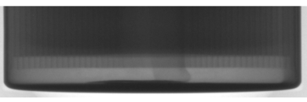
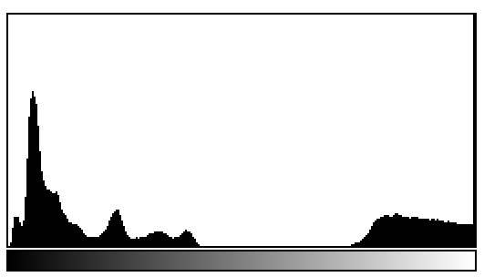
Warming up project
Warming up project: Find an optimal stretching curve to this cylinder battery image
Source image
x1,x2,x3,x4 are chosen from the histogram of input image
Use the below stretching function and y2 and y3 are experimentally chosen to show a best enhanced image. Our aim is to enhance the pole area. (y1= 0, y4=255)
y4
y3
y2
x1 x2 x3 x4

Slide 3
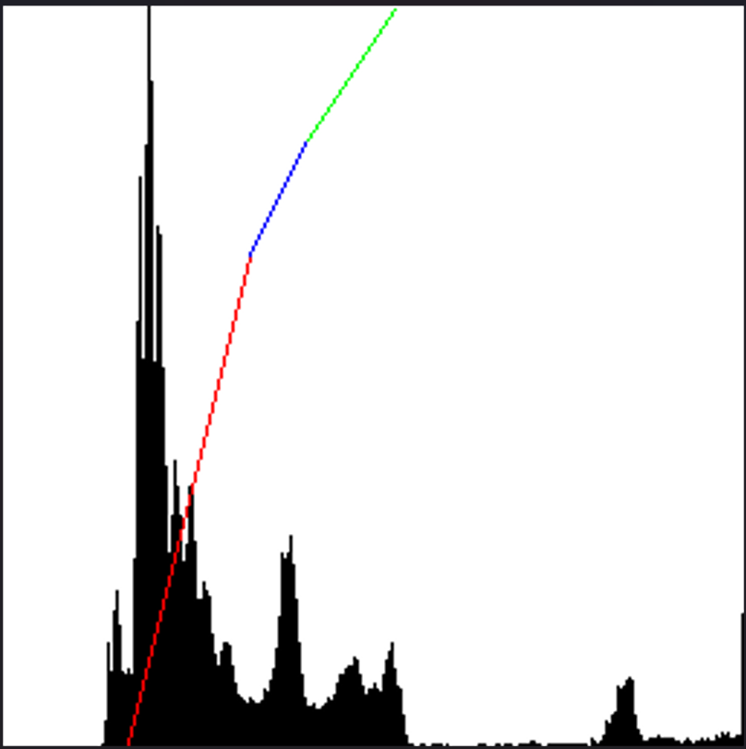
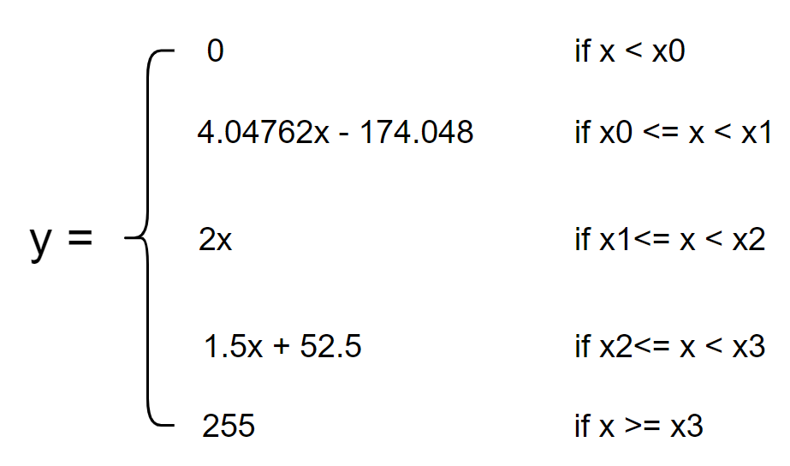
Histogram
255
Y3
Based on the histogram of source image, we can detect 4 point X
X = {43, 85, 105, 135}
Y2
When programing process I chosen Y1 = 170 and Y2 = 210
Y1
Y = {0, 170, 210, 255}
From X and Y, I have a linear equation
Output value pixels
Y0
0
X0
X1
X2
X3
255
Input value pixels

Slide 4
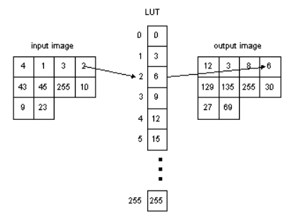
LookupTable Function
Using linear equation to calculate a table(1, 256)
Using LUT function to mapping input value to output
value.
dst(x,y) = table[src(x,y)]

Slide 5
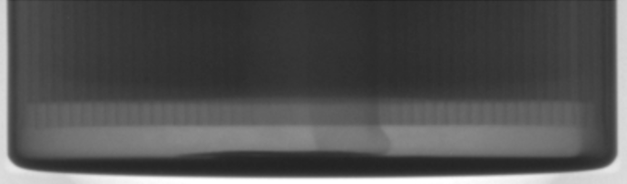
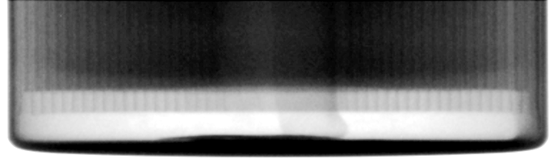
Result
Source image
Destination image

Slide 6
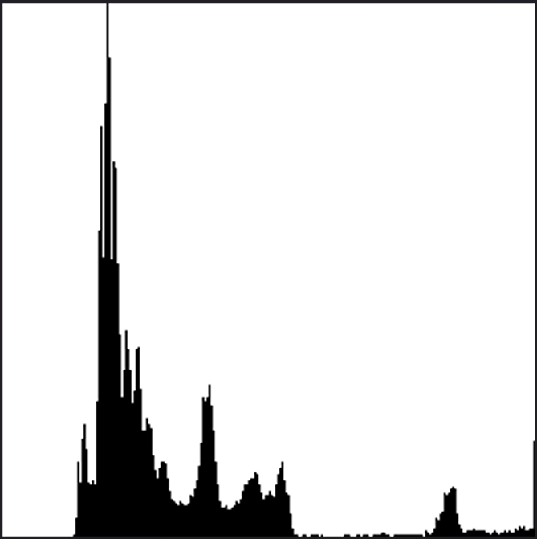
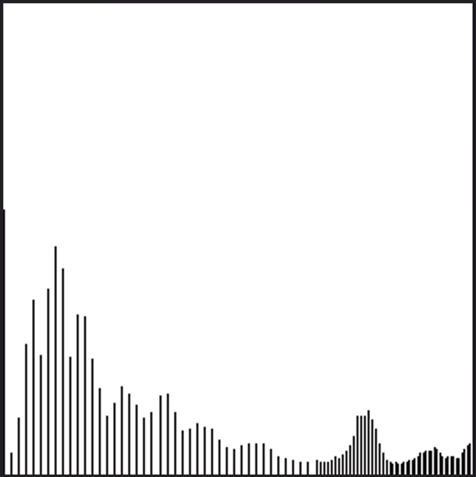
Result
Histogram of destination image
Histogram of source image

